Slide 1

SECD2523 DATABASE
TOPIC 6A | LOGICAL DATABASE DESIGN
Content adapted from Connolly, T., Begg, C., 2015. Database Systems: A Practical Approach to Design, Implementation, and Management, Global Edition. Pearson Education.

Slide 2
LECTURE LEARNING OUTCOME
By the end of this lecture, students should be able to:
01
Derive a logical data model from conceptual ERD.
02
Derive a set of relations from a local logical data model.
03
Validate these relations using the technique of normalization.
04
Validate a logical data model to ensure it supports required user transactions.
05
Merge local logical data models based on specific views into a global logical data model of the enterprise.

Slide 3
Logical Database Design Phase:
METHODOLOGY REVIEW:
  Build and validate local logical data model
    Input: Conceptual data model (e.g.: conceptual ERD) & Data dictionary
    Output: Relational DB schemas (e.g.: the relations) & Logical data model (e.g.: Logical ERD)
  Steps:
    Derive relations for local logical data model
    Validate relations using normalization
    Validate relations against user transactions
    Define integrity constraints
    Review local logical data model with user
    Merge logical data models into global model (optional)
    Check for future growth

Slide 4
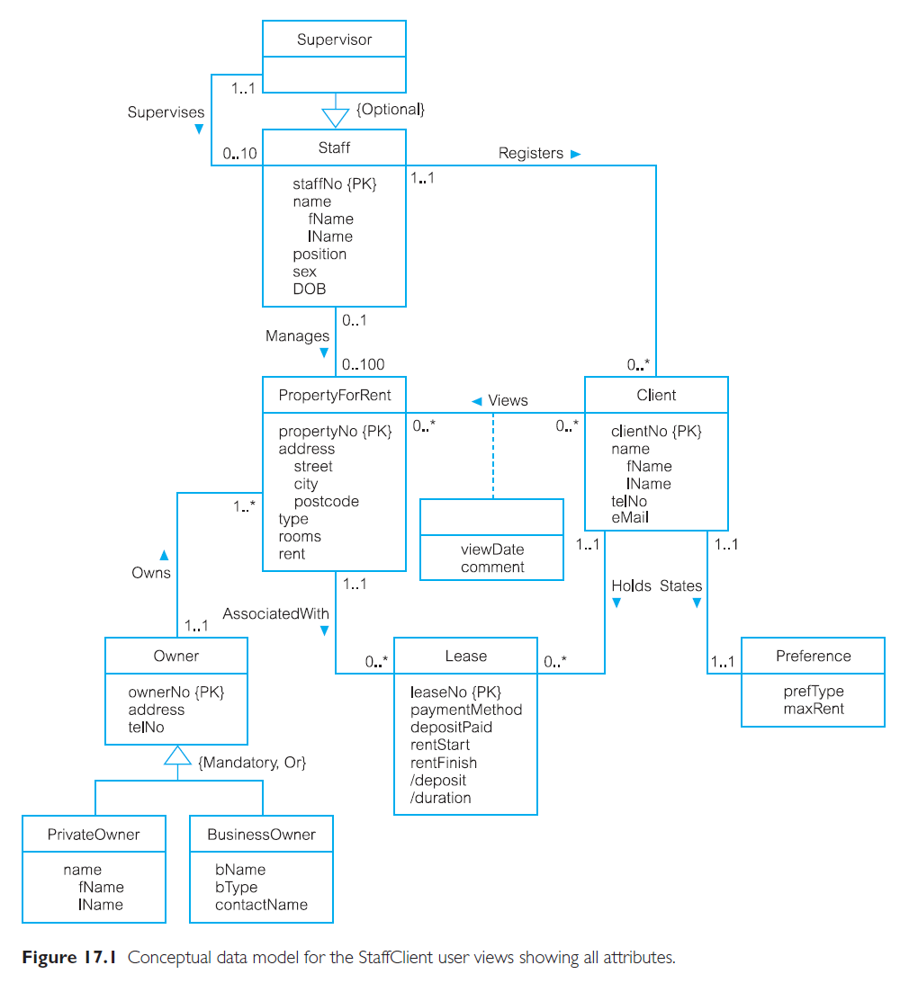
Local conceptual data model: Staff View
we are using this data model as examples

Slide 5
STEP 1:
Derive Relations for Local Logical Data Model
Purpose:
  To create relations for the local logical data model that represent the entities, relationships, and attributes identified in the conceptual data model (conceptual ERD – cERD).
  Must consider following structure you may have in cERD:
    Strong entity type
    Weak entity type
    One-to-many (1:*) binary relationship types
    One-to-one (1:1) binary relationship types
    Superclass/subclass relationship types
    Many-to-many (*:*) binary relationship types
    Recursive relationship types
    Complex relationship types
    Multi-valued attributes

Slide 6
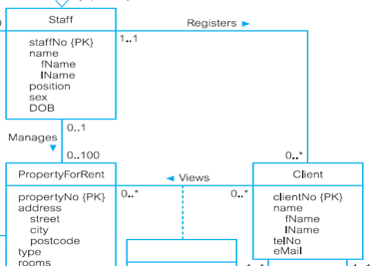
STEP 1:
Derive Relations for Local Logical Data Model
Strong entity types
  Create a relation for each strong entity that includes all simple attributes of that entity.
  For composite attributes, include only constituent simple attributes.
Portion of ERD from slide 4
Strong entity (from slide 4): ** entity with PK identified
  Staff, Client, PropertyForRent, Lease, Owner
  STAFF (staffNo, fName, lName, position, sex, DOB)
  CLIENT (clientNo, fName, lName, telNo)

Slide 7
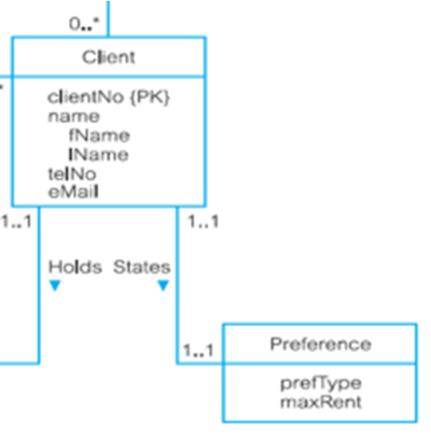

STEP 1:
Derive Relations for Local Logical Data Model
Weak entity types
  Create a relation that includes all simple attributes of that entity.
  Primary key is partially or fully derived from each owner entity
    Usually can be made after all relationship with owner entities have been mapped.
Example of weak entity:
  Preference
    PREFERENCE (prefType, maxRent)
      Primary Key : None (at present)

Slide 8
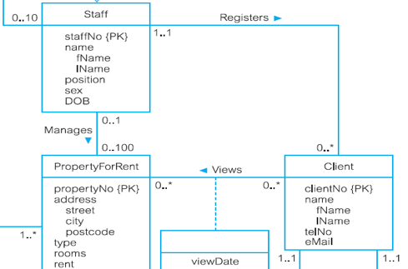
STEP 1:
Derive Relations for Local Logical Data Model
One-to-many (1:*) binary relationship types
  Identify parent & child entity by using cardinality.
    Entity on ‘one’ side is designated as parent entity.
    Entity on ‘many’ side is the child entity.
  Copy the primary key attribute of parent entity into relation representing child entity, to act as a foreign key.
Relationship Registers between Staff and Client
  Parent → Staff Child → Client
STAFF (staffNo, fName, lName, position, sex, DOB)
CLIENT (clientNo, fName, lName, telNo, staffNo)

Slide 9
STEP 1:
Derive Relations for Local Logical Data Model
One-to-one (1:1) binary relationship types
  More complex as cardinality cannot be used to identify parent and child entities in a relationship.
  Use participation to decide whether to combine entities to produce one relation or to create two relations and post copy of primary key from one relation to another.
  Consider the following participation constraint:
    Mandatory participation on both sides;
    Mandatory participation on one side, optional on the another;
    Optional participation on both sides;

Slide 10
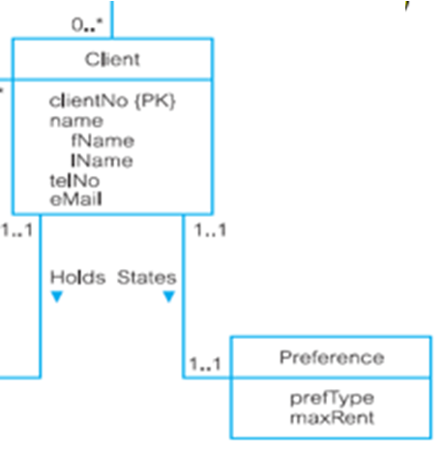
STEP 1:
Derive Relations for Local Logical Data Model
One-to-one (1:1) binary relationship types
a) Mandatory participation on both sides
  Combine entities involved into one relation.
  Choose one of the primary keys of original entities to be primary key of new relation, while other (if exists) is used as an alternate key.
Relationship States between Client and Preference
→ combine Client & Preference
CLIENT_PREF (clientNo, fName, lName, telNo, prefType, maxRent, staffNo)
  Fk: staffNo references Staff(staffNo)
  Notes: ** Relation PREFERENCE no longer exist
  ** Relation CLIENT is renamed as CLIENT_PREF

Slide 11
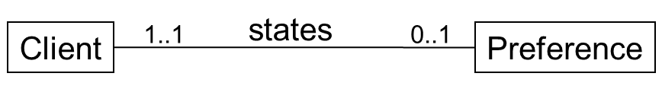
STEP 1:
Derive Relations for Local Logical Data Model
One-to-one (1:1) binary relationship types
b) Mandatory participation on one side, optional on another
  Entity with optional participation is the parent.
  Entity with mandatory participation is child.
  Create one relation for each entity, then copy PK of parent into child relation.
Client → optional Preference → mandatory
→ parent → child
CLIENT (clientNo, fName, lName, telNo, staffNo)
FK: staffNo references Staff(staffNo)
PREFERENCE (clientNo, prefType, maxRent)
FK: clientNo references Client(clientNo)

Slide 12
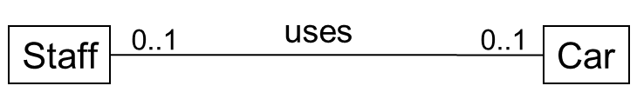
STEP 1:
Derive Relations for Local Logical Data Model
One-to-one (1:1) binary relationship types
c) Optional participation on both sides
  Designation of the parent and child entities is arbitrary unless can find out more about the relationship.
  Must try to understand more about the relationship
    Entity which is closer to being optional is the parent.
    Entity which is closer to being mandatory is the child.
  Create a relation for each entity, then copy PK of parent into child.
Assume majority of cars, but not all, are used by staff and only minority of staff use cars.
Car entity, although optional, is closer to being mandatory than Staff entity.
Therefore, designate Staff as parent entity and Car as child entity.
STAFF (staffNo, sName)
CAR (carNo, staffNo)

Slide 13
STEP 1:
Derive Relations for Local Logical Data Model
Superclass/subclass relationship types
  Designate superclass as parent entity and subclass as child entity.
  There are various options on how to represent such a relationship as one or more relations.
  Most appropriate option depends on number of factors such as:
    Disjoint and participation constraints on the superclass/subclass relationship.
    Whether subclasses are involved in distinct relationships,
    Number of participants in superclass/subclass relationship.

Slide 14
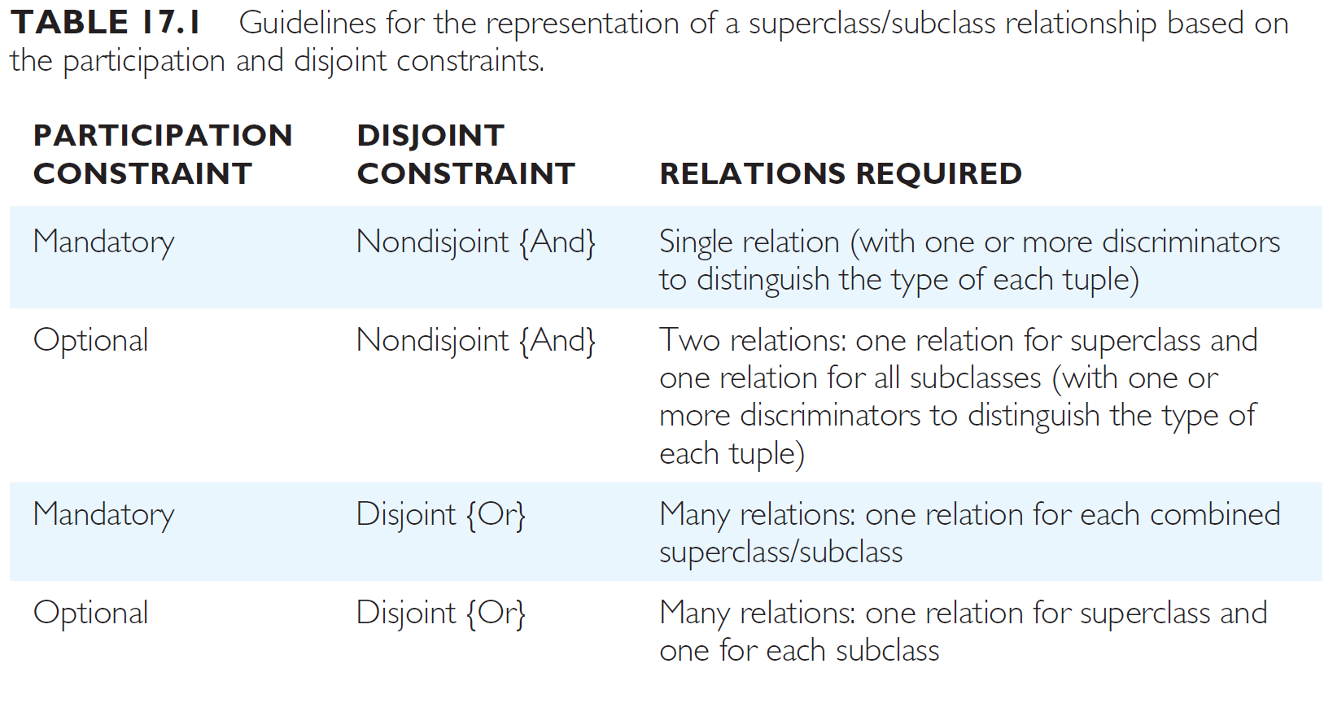
STEP 1:
Derive Relations for Local Logical Data Model
Superclass/subclass relationship types

Slide 15
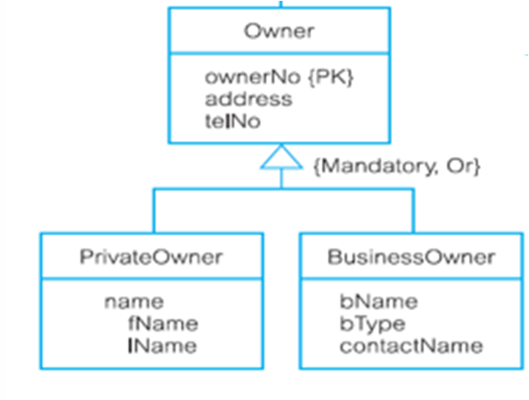
STEP 1:
Derive Relations for Local Logical Data Model
Superclass/subclass relationship types
Guideline No 3:
PRIVATEOWNER (ownerNo, fName, lName, address, telNo)
BUSINESSOWNER (ownerNo, bName, bType, contactName, address, telNo)

Slide 16
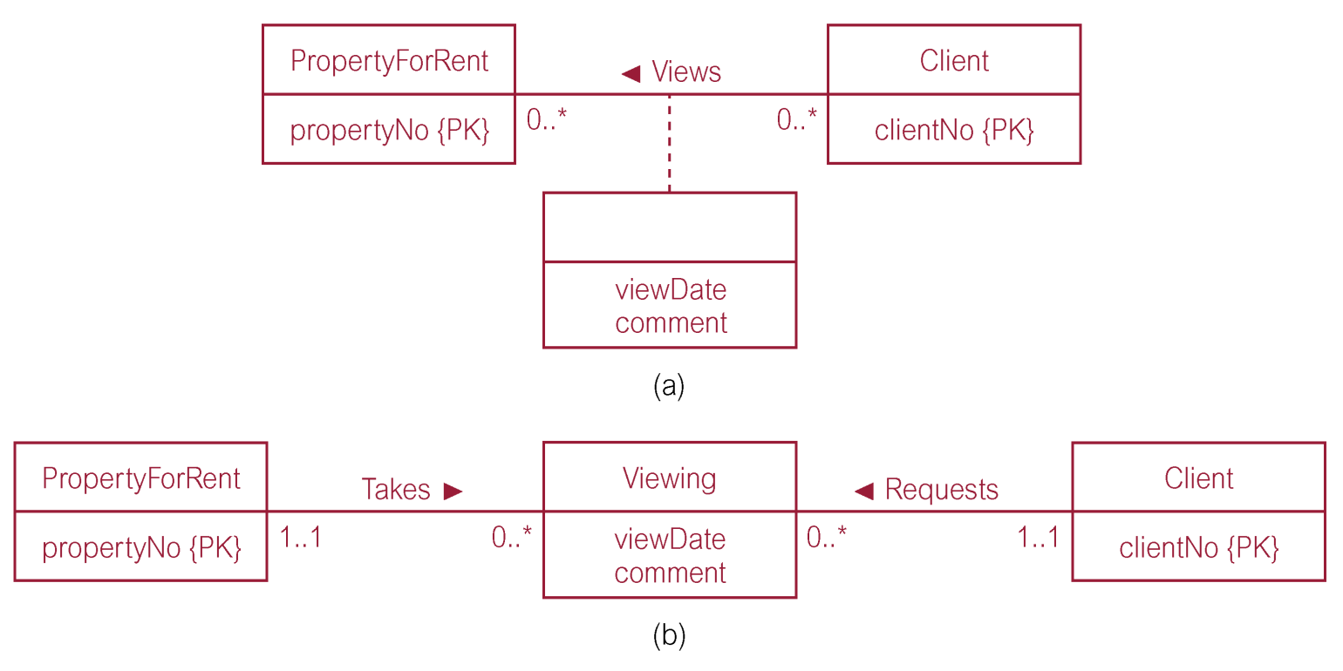
STEP 1:
Derive Relations for Local Logical Data Model
Many-to-many (*:*) binary relationship types
Option 1
  First, transform *:* relationships by creating two 1:* relationships
  Then, create relations from the transformed diagram
Original:
Transformed:

Slide 17
STEP 1:
Derive Relations for Local Logical Data Model
Many-to-many (*:*) binary relationship types
Option 1
Relations:
  PROPERTYFORRENT (propertyNo, street, city, postcode, type, rooms, rent)
  VIEWING (propertyNo, clientNo, viewDate, comment)
  CLIENT_PREF (clientNo, fName, lName, telNo, prefType, maxRent, staffNo)
  Note: recall that relation CLIENT_PREF is the result from our earlier work on deriving relation for 1..1 binary relationship

Slide 18
Derive Relations for Local Logical Data Model
Many-to-many (*:*) binary relationship types
Option 2
  Create a new relation to represent the relationship and include any attributes that are part of relationship.
  Copy the primary key attribute(s) of the entities that participate in relationship into the new relation.
    This attribute(s) is now acting as foreign key in the new relation.
    This attribute (the FK) is also the primary key of new relation, possibly in combination with some of the attributes of the relationships
CLIENT_PREF (clientNo, fName, lName, telNo, prefType, maxRent, staffNo)
PROPERTYFORRENT (propertyNo, street, city, postcode, type, rooms, rent)
VIEWING (clientNo, propertyNo, viewDate, comment)

Slide 19
Derive Relations for Local Logical Data Model
Recursive relationship type
1:1 recursive relationships
  Use rules for participation for a 1:1 relationship
  Mandatory participation on both sides:
    Represent recursive relationship as a single relation with two copies of the primary key
    One copy of the primary key represents a foreign key and should be renamed to represent the relationship it presents.
supervise
SUPERVISION (staffNo, superviseeNo)
PK : staffNo
FK1: staffNo references Staff(staffNo)
FK2: superviseeNo references Staff(staffNo)
1..1
staff
1..1

Slide 20
Derive Relations for Local Logical Data Model
Recursive relationship type
1:1 recursive relationships
  Mandatory participation on only one side:
    Option 1 → Create a single relation with two copies of primary key
    Option 2 → Create a new relation to represent the relationship.
    The new relation would only have two attributes, both copies of the primary key.
STAFF (staffNo, superviseeNo)
PK: staffNo
FK: superviseeNo reference STAFF(staffNo)
Option 1
supervise
0..1
SUPERVISE (staffNo, superviseeNo)
PK: staffNo
FK: superviseeNo reference STAFF(staffNo)
staff
Option 2
1..1

Slide 21
Derive Relations for Local Logical Data Model
Recursive relationship type
1:1 recursive relationships
  Optional participation on both sides:
    Create a new relation as described above
SUPERVISE (staffNo, superviseeNo)
PK: staffNo
FK: superviseeNo reference STAFF(staffNo)
supervise
0..1
staff
0..1

Slide 22
Derive Relations for Local Logical Data Model
Recursive relationship type
*:* recursive relationships
  Transform *:* recursive relationship into 1:* binary relationship
  Create relations to represent relationships from the transformed diagram, follow rules for participation 1:*
    Entity on ‘one’ side is designated the parent entity and entity on ‘many’ side is the child entity.
    Copy the primary key attribute(s) of parent entity into relation representing child entity, to act as a foreign key

Slide 23
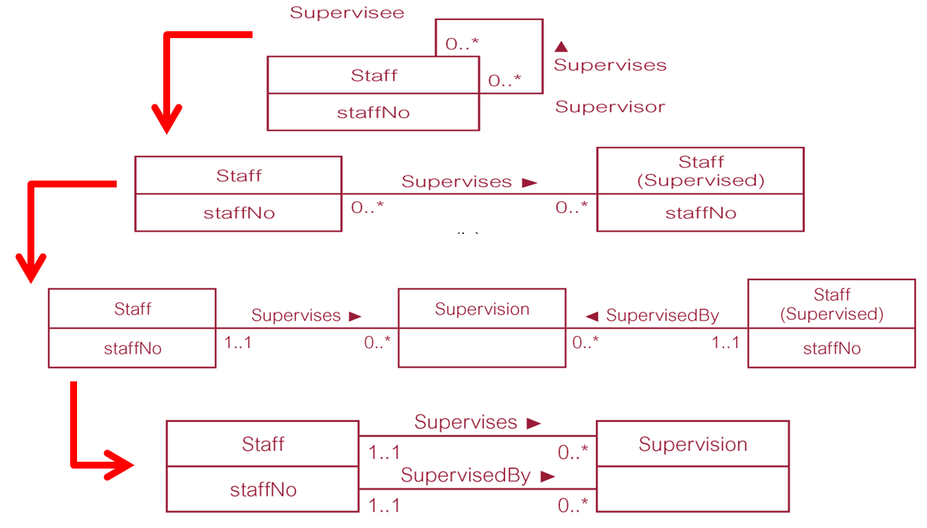
Derive Relations for Local Logical Data Model
Recursive relationship type
*:* recursive relationships

Slide 24
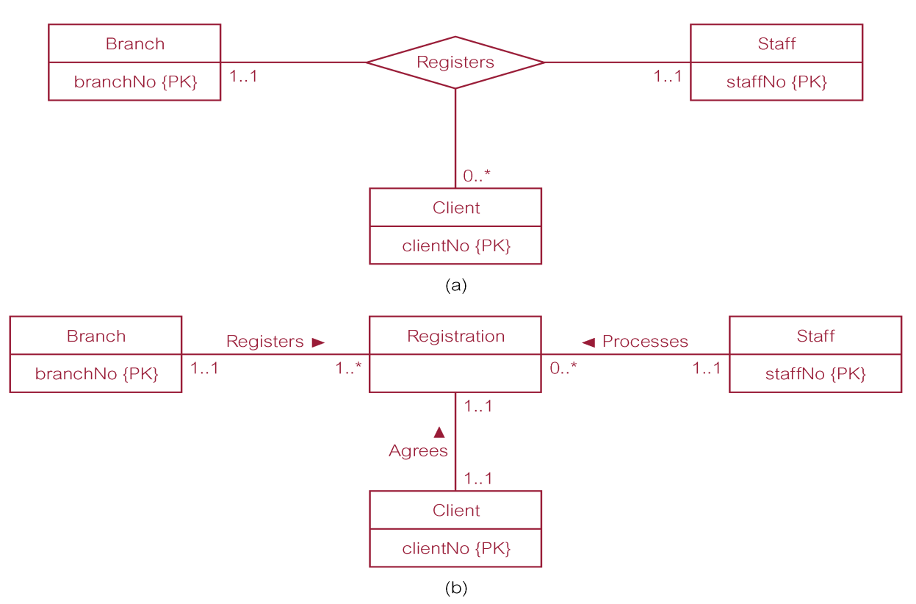
Derive Relations for Local Logical Data Model
Complex relationship types
Option 1:
  Transform *:* relationship by creating a new entity and binary relationships between original entities with this new entity.
  Create relations for all entities (follow appropriate rules for binary relationships)

Slide 25
Derive Relations for Local Logical Data Model
Complex relationship types
Option 2:
  Create relation to represent relationship and include any attributes that are part of the relationship.
  Copy primary key attribute(s) of entities that participate in the complex relationship into new relation, to act as foreign keys.
  Any foreign keys that represent a ‘many’ relationship (for example, 1..*, 0..*) generally will also form the primary key of new relation, possibly in combination with some of the attributes of the relationship.

Slide 26
Derive Relations for Local Logical Data Model
Complex relationship types
Option 2:
REGISTRATION (clientNo, branchNo, staffNo)
PK: clientNo
FK1: clientNo references CLIENT (clientNo)
FK2: branchNo references BRANCH (branchNo)
FK3: staffNo reference STAFF (staffNo)

Slide 27
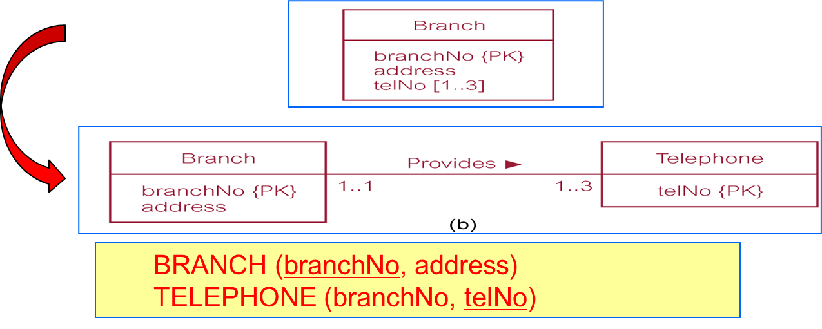
Derive Relations for Local Logical Data Model
Multi-valued attributes
Option 1:
  Remove multi-valued attribute from original entity and put in new entity
  Create relationship between original entity to newly formed entity

Slide 28
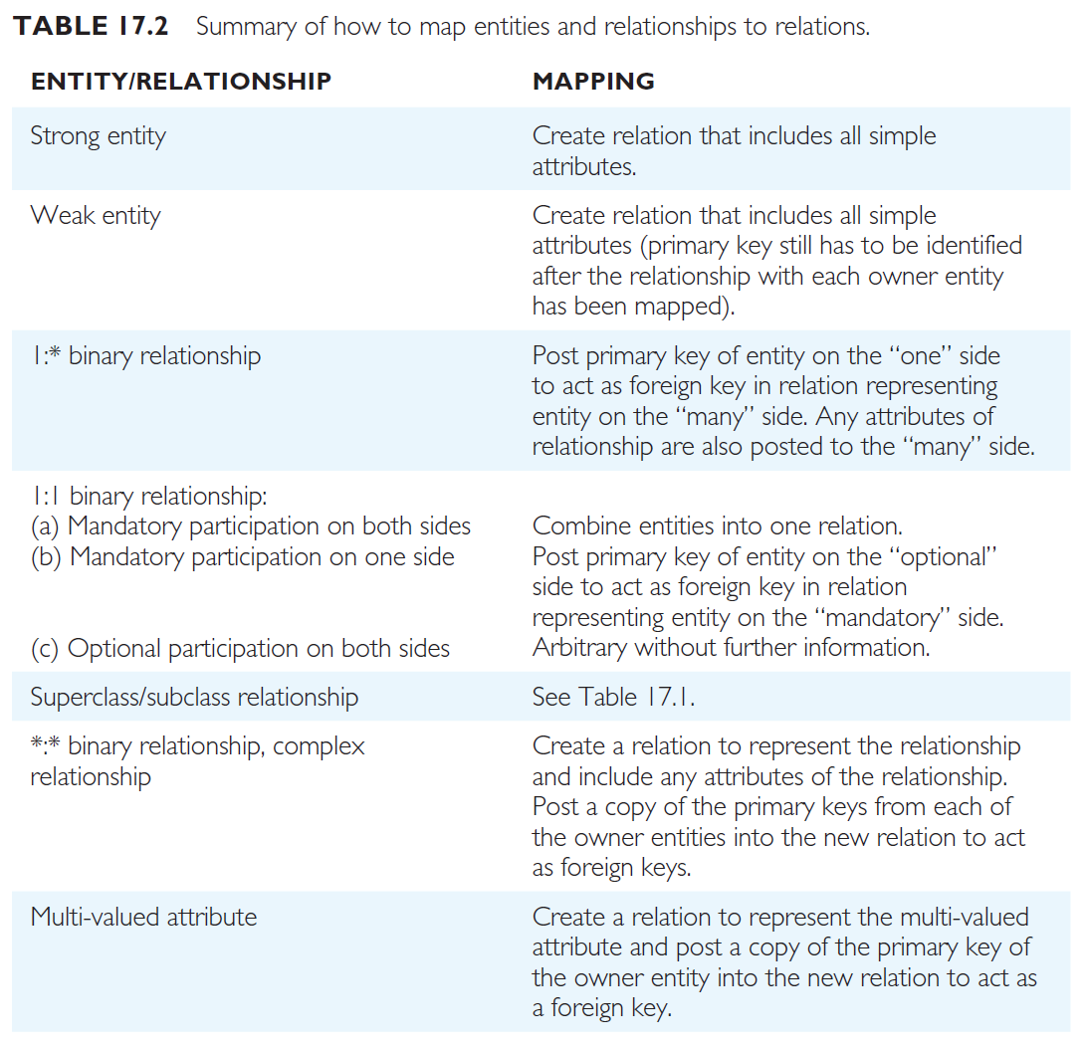
Summary Derive Relation

Slide 29
Local conceptual data model: Staff View

Slide 30
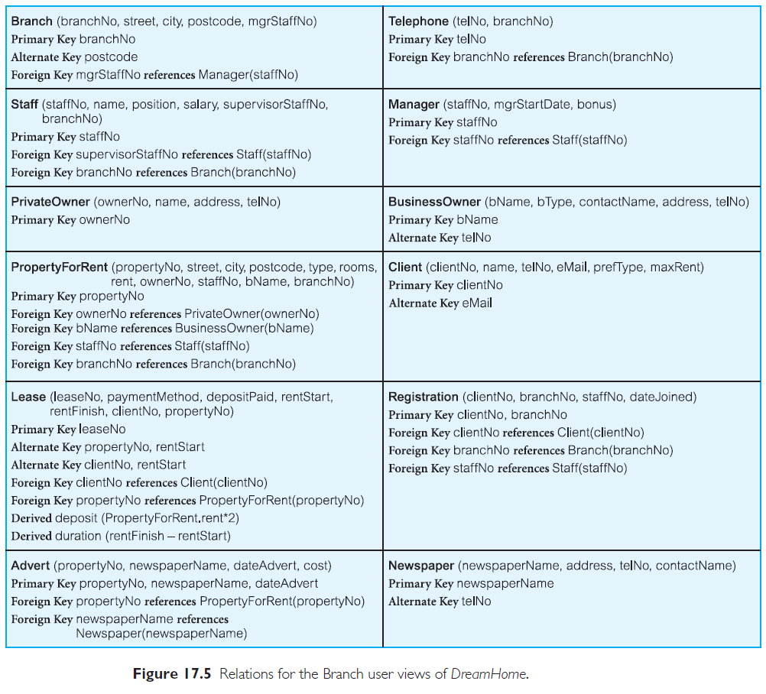
Relations for the Staff View of DreamHome

Slide 31
Practice 1: Derive Relations
Customers
Product
custNo {PK}
Product
Order
firstName
prodNo {PK}
involves
place
orderNo {PK}
lastName
desc
dateDue
street
cost
1..*
totalPrice
city
1..*
1..*
1..*
0..*
0..*
1..1
price
1..1
status
postcode
noInStock
custTelNo
noAllocated
credLimit
quantity
totalPrice
status

Slide 32
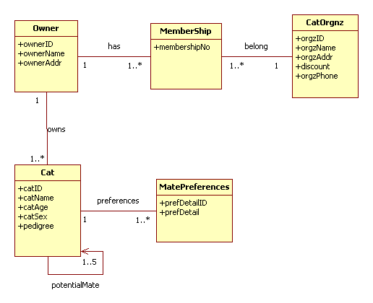
Practice 2: Derive Relations

Slide 33
Practice 3: Derive Relations

Slide 34
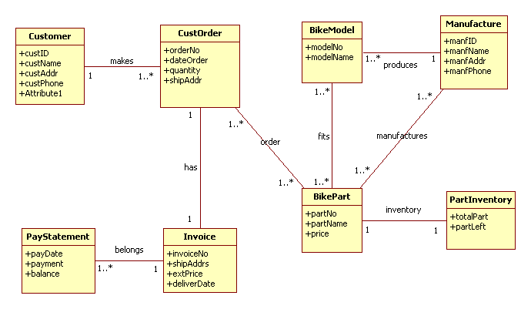
Practice 4: Derive Relations

Slide 35
The rest of steps in logical DB design:
Step 2.2 Validate relations using normalization
  To validate the relations in the local logical data model using the technique of normalization (details will be discussed in Chapter Normalization).
Step 2.3 Validate relations against user transactions
  To ensure that the relations in the local logical data model support the transactions required by the view.
Step 2.4 Check integrity constraints
  To check that integrity constraints are represented in logical data model (i.e. required data, entity and referential integrity, domains, and enterprise constraints).
Step 2.5 Review local logical data model with user
  To ensure that the local logical data model and supporting documentation that describes the model is a true representation of the view.

Slide 36
The rest of steps in logical DB design:
Step 2.6 Merge local logical data models into global model (optional step)
  To merge the individual local logical data models into a single global logical data model of the enterprise that represents all user views of a database.
    2.6.1 Merge logical data models into global logical data model
    2.6.2 Validate global logical data model
    2.6.3 Review global logical data model with users
Step 2.7 Check for future growth
  To determine whether there are any significant changes likely in the foreseeable future and to assess whether the global logical data model can accommodate these changes.

Slide 37


